Slide 1
Seminar (PHN-699) and Dissertation Stage-I (PH-600A) Presentation Supervisor – Dr H S Nataraj
Laksh Arora
20615013
Notes:
Good Morning Everyone. This is Laksh Arora presenting my seminar and dissertation stage 1 presentations. My supervisor is professor H S Nataraj.

Slide 2
Seminar Optical Frequency Combs
Notes:
My seminar topic is Optical Frequency Combs

Slide 3
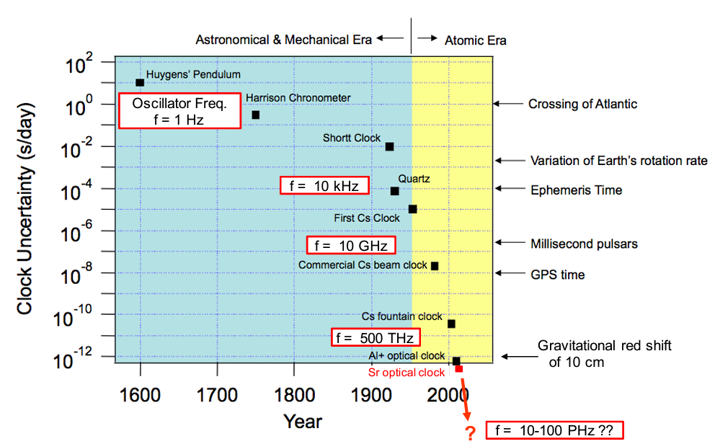
Introduction
Notes:
This is a rough chart on the progression of time keeping. It shows the clock uncertainty in seconds/day as a function of year. So, down is better. In 1600, pendulum clocks, approximately 1 s/day.
Around 1950, there was a transition from mechanical to atomic clocks with the first Cs clock In 1967, the international standard unit of time, the SI second was redefined as 9,192,631,770 oscillations between two hyper-fine states in 133Cs. Since then we can see that there has been a rapid improvement and now we have optical clocks. Important thing to note here is that the fundamental frequency of the clock has been increasing.

Slide 4
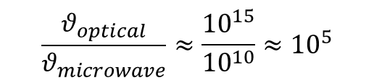
Introduction
$$\frac{θ_{optical}}{θ_{microwave}}≈\frac{{10}^{15}}{{10}^{10}}≈{10}^{5}$$
How to measure optical frequencies?
Early optical clockworks have been frequency chains, which were rather difficult and expensive to set up and stably operate over long times.
The advent of very broadband mode-locked lasers has made it possible to realize by far simpler optical clockworks
Nobel Prize in Physics, 2005 to John L. Hall and Theodor W. Hänsch for making pioneering contributions to the optical frequency comb technique.
Notes:
Optical frequency combs were first developed nearly two decades ago to support the world’s most precise atomic clocks. While 133Cs microwave clocks provide 16 digits in frequency/time accuracy, clocks based on optical transitions in atoms are being explored as alternative references because higher transition frequencies permit greater than a 100 times improvement in time/frequency resolution. Optical signals, however, pose a significant measurement challenge because light frequencies oscillate 100,000 times faster than state-of-the-art digital electronics. In 2000, the realization of the OFC allowed for vast simplification to precision optical measurement and rapid progress and development into optical atomic standards.
The Nobel Prize in Physics was awarded to Roy J. Glauber, John L. Hall and Theodor W. Hänsch in 2005. The latter two have made pioneering contributions to the development of the optical frequency comb technique.

Slide 5
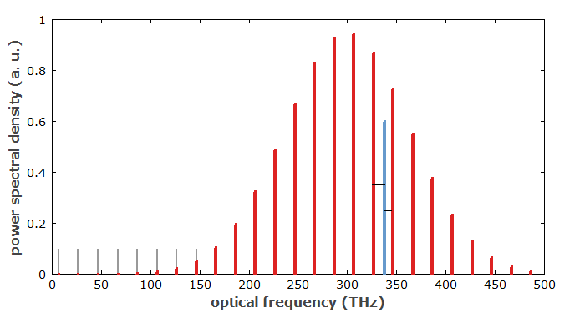

What is an Optical Frequency Comb (OFC)?
Optical spectrum with equidistant frequency lines (hence, comb).
Associated with a regular train of short pulses, with fixed pulse repetition rate ($f_{r}$) which determines the line spacing.
Can be used as a ‘optical ruler’. If comb frequencies are known, beat notes can be measured.
For a wide frequency range, higher bandwidth is needed.
Notes:
An optical frequency comb is an optical spectrum which consists of equidistant lines (Figure 1), i.e., it has equidistant optical frequency components, while the intensity of the comb lines can vary substantially. Usually, such kind of optical spectrum is associated with a regular train of ultrashort pulses, having a fixed pulse repetition rate which determines the inverse line spacing in the spectrum. To understand how such a spectral shape arises, one has to consider the properties of Fourier transforms, translating the complex amplitudes from the time domain to the frequency domain.
A frequency comb can be used as an optical ruler: If the comb frequencies are known, the frequency comb can be used e.g. to measure unknown frequencies by measuring beat notes, which reveal the difference in frequency between the unknown frequency and the comb frequencies. For performing such measurements in a wide frequency range, a large overall bandwidth of the frequency comb is needed.
Early attempts to produce broadband frequency combs were based on electro-optic modulators, which can impose dozens of sidebands on a single-frequency input beam from a single-frequency continuous-wave laser.
Afterwards, it was realized that a femtosecond mode-locked laser can actually be used very well for generating very broadband frequency combs: the optical spectrum of a periodic pulse train, as generated in a mode-locked laser, consists of discrete lines with an exactly constant spacing which equals the pulse repetition frequency. If the pulse duration gets far below 1 ps, the optical spectrum becomes very wide, leading to a very broad frequency comb.

Slide 6
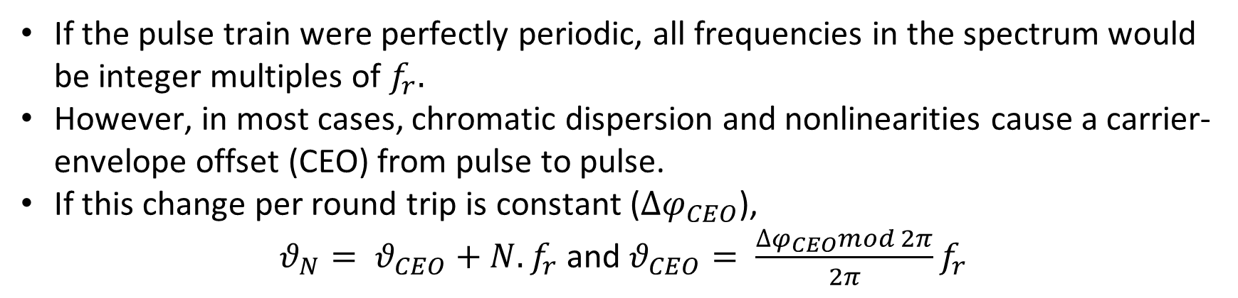
What is an Optical Frequency Comb (OFC)?
If the pulse train were perfectly periodic, all frequencies in the spectrum would be integer multiples of $f_{r}.$
However, in most cases, chromatic dispersion and nonlinearities cause a carrier-envelope offset (CEO) from pulse to pulse.
If this change per round trip is constant ($∆φ_{CEO}$),
$θ_{N}= θ_{CEO}+N.f_{r}$ and $θ_{CEO}= \frac{∆φ_{CEO}mod 2π}{2π}f_{r}$
Notes:
If the pulse train were perfectly periodic – not only concerning the intensity versus time but also with respect to the electric field –, all the frequencies of the lines in the spectrum would be integer multiples (harmonics) of the pulse repetition rate. In most cases, however, intracavity chromatic dispersion and nonlinearities cause a slip of the carrier–envelope offset (CEO) from pulse to pulse, i.e., the oscillations of the electric field are constantly shifted with respect to the pulse envelope (Figure 2). If the change in the carrier–envelope offset per resonator round trip is a constant (denoted Δφceo), all optical line frequencies can be written as where N is an integer index, fr is the pulse repetition rate and is the CEO frequency, which according to this definition can be between 0 and fr.
PS Non-linearities
Certain crystal materials have nonlinear polarization which is proportional to the square (or to products) of electric field strength components. The Kerr effect raises the refractive index by an amount which is proportional to the intensity.
Two-photon absorption is a process where two photons are simultaneously absorbed, leading to an excitation for which a single photon energy would not be sufficient.
Saturation of gain occurs particularly in lasers and amplifiers.
There are nonlinear losses in saturable absorbers which are used for passive mode locking or Q switching.
There are various kinds of effects involving heating of the laser cavity
Strong nonlinearities also occur at intensities which are high enough to cause ionization in the medium. This can lead to optical breakdown, possibly even associated with laser-induced damage of the material.
PS on chromatic dispersion
The chromatic dispersion of an optical material is the phenomenon that the phase velocity and group velocity of light propagating in a transparent medium depend on the optical frequency. That dependency results mostly from the interaction of light with electrons of the medium, and is related to absorption in some spectral regions; see the article on Kramers–Kronig relations. A quantitative measure is the group velocity dispersion.

Slide 7
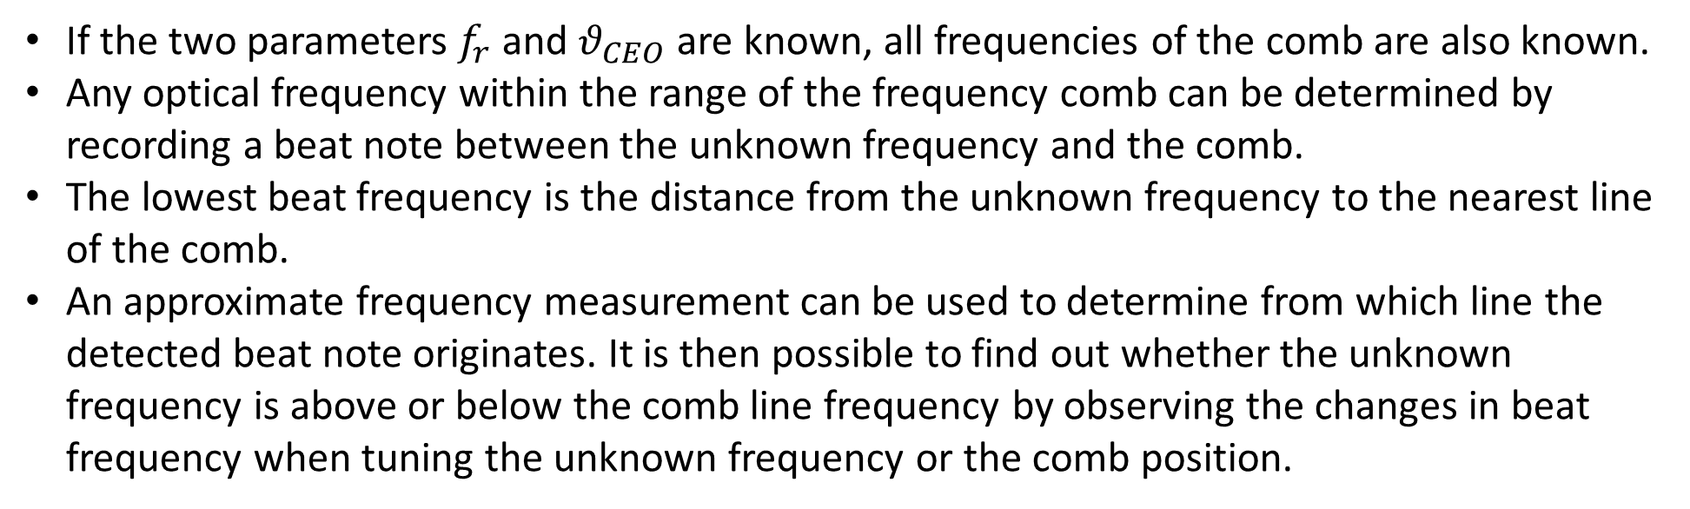
Measuring the unknown frequency using OFC
If the two parameters $f_{r}$ and $θ_{CEO}$ are known, all frequencies of the comb are also known.
Any optical frequency within the range of the frequency comb can be determined by recording a beat note between the unknown frequency and the comb.
The lowest beat frequency is the distance from the unknown frequency to the nearest line of the comb.
An approximate frequency measurement can be used to determine from which line the detected beat note originates. It is then possible to find out whether the unknown frequency is above or below the comb line frequency by observing the changes in beat frequency when tuning the unknown frequency or the comb position.
Notes:
If the two parameters frep and νceo are known, all frequencies of the comb are also known. In that case, any optical frequency within the range of the frequency comb can be determined by recording a beat note between the unknown frequency and the comb. The lowest beat frequency is the distance from the unknown frequency to the nearest line of the comb (see Figure 1). An approximate frequency measurement (e.g. with a wavemeter) can be used to determine from which line the detected beat note originates. It is then possible to find out whether the unknown frequency is above or below the comb line frequency, e.g. by observing the changes in beat frequency when tuning the unknown frequency or the comb position.

Slide 8
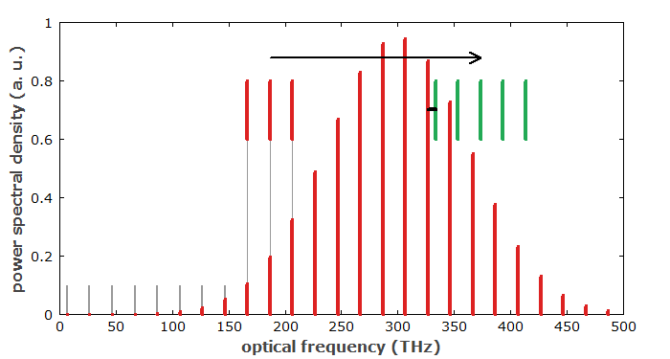


Measuring $f_{r}$ and $θ_{CEO}$
The pulse repetition rate $f_{r}$ is easily measured with a fast photodiode.
Measurement of $θ_{CEO}$ is significantly more difficult.
We can use a $f−2f$ self-referencing scheme where one uses a beat note between the frequency doubled lower end of the comb spectrum with the higher frequency end, if the spectrum covers an optical octave.
Notes:
The pulse repetition rate frep is easily measured with a fast photodiode, whereas the measurement of νceo is significantly more difficult. It can be detected e.g. via an interferometric f−2f self-referencing scheme [4, 5], where one uses a beat note between the frequency-doubled lower-frequency end of the comb spectrum with the higher-frequency end (Figure 3), if the spectrum covers an optical octave. (Modified methods, using e.g. a 2f−3f self-referencing scheme, involve a beat note between different harmonics of the laser light.) Such broad spectra can be achieved e.g. with supercontinuum generation in photonic crystal fibers, if the laser output itself does not have a sufficiently large bandwidth. It is possible, however, to generate octave-spanning spectra directly with titanium–sapphire lasers [10].

Slide 9
Applications of Frequency Combs
1. Optical Clockwork.
In analogy with a mechanical clockwork, an optical clockwork is a device which phase-coherently relates a high and a low frequency and can serve as a central ingredient of an optical clock.
The higher frequency is an optical frequency, i.e., typically in the range of 100-500 THz, whereas the lower frequency is typically in the microwave region (e.g. between 1 and 100 GHz), so that it can be processed with fast electronics and easily related to even lower frequencies.
Notes:
For a range of applications it is necessary to determine accurately the absolute frequencies of optical signals.
In analogy with a mechanical clockwork, an optical clockwork is a device which phase-coherently relates a high and a low frequency and can serve as a central ingredient of an optical clock. The higher frequency is an optical frequency, i.e., typically in the range of hundreds of terahertz, whereas the lower frequency is typically in the microwave region (e.g. between 1 and 100 GHz), so that it can be processed with fast electronics and easily related to even lower frequencies. An optical clockwork can thus relate an optical frequency standard to an electronic one, the latter being based on, for example, a cesium atomic clock.

Slide 10
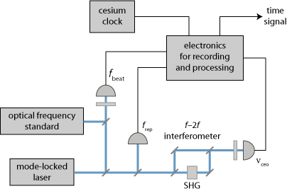
Applications of Frequency Combs
It is thus possible to phase-coherently compare the frequencies of the optical standard and a cesium clock and correct the timing signal of the latter, using the superior stability of the optical frequency standard.
Notes:
The advent of very broadband mode-locked lasers has made it possible to realize by far simpler optical clockworks, as the output of such a laser is a frequency comb, where all frequencies occurring are determined by just two parameters: the pulse repetition frequency and the carrier–envelope offset frequency. An optical frequency from some frequency standard (e.g. a single ion in a Paul trap) can then be expressed by the sum of the carrier–envelope offset frequency, a certain integer multiple of the pulse repetition frequency, and a beat note frequency, which can all be measured and processed with fast electronics. It is thus possible to phase-coherently compare the frequencies of the optical standard and a cesium clock and correct the timing signal of the latter, using the superior stability of the optical frequency standard. Figure 1 shows the setup of an optical clock which can be realized in that way.

Slide 11
Applications of Frequency Combs
Timing and Synchronisation.
For new definition of SI second
Better GPS
Data collection in high-resolution measurements
Notes:
the frequency comb technique is much simpler than that based on a traditional frequency chain, and it makes it possible to construct very compact frequency reference sources and frequency measurement devices. Moreover, it delivers closely spaced lines of known frequencies in a wide spectral range, allowing for frequency measurements in this wide range, rather than only around a single optical frequency as for a frequency chain.
the primary motivator for the development of optical clock networks is the realization of an optical SI second.
However, this realization will require the networking of an international ensemble of atomic clocks for a distributed and democratic realization of optical- universal coordinated time. While microwave clocks are currently linked internationally by the Global Positioning Systems (GPS) and 2-way satellite time transfer, the stability of these systems can only achieve a transfer stability of 10−16 after one month of averaging, which is insufﬁcient to support the timing capabilities of the best atomic clocks.
Aside from clock-based applications, the dissemination of ultra-high-stability timing signals is also a necessity in the context of large-scale science facilities for remote synchronization of physical events and data collection in high-resolution measurements.

Slide 12
Applications of Frequency Combs
High Precision Spectroscopy.
High Precision Atomic and Molecular Spectroscopy
Astronomy
Exoplanet searching
Measure radial velocities od celestial bodies
Composition of solar atmospheres
Rate of expansion of universe
Notes:
OFCs were ﬁrst proposed for improved frequency calibration of astronomical spectrographs in 2007. These spectrographs measure Doppler shifts of stellar spectra to determine the radial velocities of celestial bodies, as well as the composition of solar atmospheres. Higher precision measurements that aim to discern cm/s level drifts in these Doppler shifts, can be used to assess the rate of expansion of the universe, as well as detection of the periodic wobble in stellar velocity due to the inﬂuence of an orbiting exo-planet. These small Doppler drifts are inaccessible with conventionally calibrated spectrographs due to environmental instability, and are limited by the spectral coverage and stability of traditional calibration sources. Observation of the equidistance of the OFC modes at the spectrograph’s imaging plane allows for calibration of instrument drift, improving its long-term frequency accuracy.

Slide 13
Applications of Frequency Combs
Distance Measurement and Ranging.
Fundamental Physics
Time dependence of certain quantities
Dark matter signatures
Gravitational waves.
Notes:
The application of optical frequency combs to LIDAR (light detection and ranging) was ﬁrst demonstrated in 2000 and enables a number of advantages over traditional sources. A wide range of applications, for example in architecture, inspection of fabrication halls, criminal scene investigation (CSI), and in the military.
tectors.
Furthermore, the clarification of fundamental scientific questions depends on ultraprecise time or frequency measurements; for example, such measurements are vital for checking whether there might be any time dependence of certain quantities (e.g. the fine structure constant α) which are so far considered as physical constants. If any changes of such quantities could be detected, this would have a profound impact on future theoretical descriptions of most fundamental phenomena.
To date, while high-precision clock comparisons have yet to uncover dark matter signatures or observe temporal variations of fundamental constants, these tests have been used to verify our understanding of current physical models at parts in 10^17.

Slide 14
References
Fortier, T., Baumann, E. 20 years of developments in optical frequency comb technology and applications. Commun Phys 2, 153 (2019).
Diddams, S. Fundamentals of frequency combs: What they are and how they work. KISS Workshop: “Optical Frequency Combs for Space Applications”.
RP Photonics Encyclopedia: Frequency Combs.
RP Photonics Encyclopedia: Optical Clockworks.

Slide 15
Dissertation To solve the Dirac Equation for many electron atoms using Dirac Hartree Fock Self Consistent field method

Slide 16
Hartree-Fock Method
In computational physics and chemistry, the Hartree–Fock (HF) method is a method of approximation for the determination of the wave function and the energy of a quantum many-body system in a stationary state.
The Hartree–Fock method often assumes that the exact N-body wave function of the system can be approximated by a single Slater determinant.
By invoking the variational method, one can derive a set of N-coupled equations for the N spin orbitals. A solution of these equations yields the Hartree–Fock wave function and energy of the system.

Slide 17
Self Consistency
The Hartree–Fock method is a self-consistent field method (SCF).
The final field as computed from the charge distribution is "self-consistent" with the assumed initial field. The solution is computed iteratively from an initial guess till self-consistency is reached.
The solutions to the non-linear Hartree–Fock equations also behave as if each particle is subjected to the mean field created by all other particles.
For both atoms and molecules, the Hartree–Fock solution is the central starting point for most methods that describe the many-electron system more accurately.

Slide 18
Basis Set
In modern computational chemistry, quantum chemical calculations are performed using a finite set of basis functions.
When the finite basis is expanded towards an (infinite) complete set of functions, calculations using such a basis set are said to approach the complete basis set limit.
Note, in this context, basis function and atomic orbital are sometimes used interchangeably, although the basis functions are usually not true atomic orbitals.

Slide 19
Basis Set
The physically best motivated basis set are Slater-type orbitals (STOs), which are solutions to the Schrödinger equation of hydrogen-like atoms, and decay exponentially far away from the nucleus.
Unfortunately, calculating integrals with STOs is computationally difficult and it was later realized that STOs could be approximated as linear combinations of Gaussian-type orbitals (GTOs) instead.
Because the product of two GTOs can be written as a linear combination of GTOs, integrals with Gaussian basis functions can be written in closed form, which leads to huge computational savings.
The speedup by 4-5 orders of magnitude compared to Slater orbitals outweighs the extra cost entailed by the larger number of basis functions generally required in a Gaussian calculation.

Slide 20
Basis Set
The smallest basis sets are called minimal basis sets. A minimal basis set is one in which a single basis function is used for each orbital in a Hartree–Fock calculation on the free atom.
A minimal basis set may already be exact for the gas-phase atom at the self-consistent field level of theory. But for atoms such as lithium, basis functions of p type are also added to the basis functions that correspond to the 1s and 2s orbitals of the free atom, because lithium also has a 1s2p bound state. Therefore, each atom in the second period of the periodic system (Li - Ne) would have a basis set of five functions (two s functions and three p functions).

Slide 21
Dirac-Hartree-Fock Method
Dirac-Fock (DF) Self Consistent Field (SCF) calculations can be performed on many-electron atoms using techniques similar to nonrelativistic field methods.
It crucial to impose kinetic balance between the large and small component basis to avpid variational collapse.

Slide 22
Dirac-Hartree-Fock Method
The total Dirac-Breit Hamiltonian for a many electron system has two terms- a one-electron part consisting of kinetic, mass-energy and nuclear attraction:
And the two electron part, consisting of Coulomb repulsion and Breit Interaction:

Slide 23
Dirac-Hartree-Fock Method
In the central field approximation, the solution to the Dirac equation is given by four component spinors:
Where P and Q are the large and small component of the radial wave function, while χ is the spin angular part.
κ is given by:

Slide 24
Dirac-Hartree-Fock Method
The radial functions are expanded in terms of the basis sets as:
g^{L} and g^{S} are taken to be GTOs:

Slide 25
Dirac-Hartree-Fock Method
The matrix of the form:
needs to be solved. F is the Fock matrix, C is the eigen vector, S is the overlap matrix, ε is the eigenvalue matrix.
Once this is diagonalised, we get eigenvalues and eigenvectors for both occupied and virtual orbitals. Using the lowest N spinors, we can construct the DF ground state wave function and calculate properties like total energy, kinetic energy, potential energy, orbital energy, radial expectation values, ionisation potential etc.

Slide 26
Summary
Aim- To solve the Dirac Equation for many electron atoms using Dirac-Hartree-Fock Self Consistent field method.
Work done-
Studied the theory for self-consistent field methods, including the DHF Method for many electron atoms as covered in Unit-1 of PHN-626 Advanced Atomic and Molecular Physics.

Slide 27
Work to be done next-
Run the code which is in Fortran.
Rewrite the complete code in MATLAB. It is better features for plotting etc. This will also help foster better understanding.

Slide 28
References
Nataraj, H. S., Notes, Unit-1 Many electron atoms, PHN-626 Advanced Atomic and Molecular Physics (2021), IIT Roorkee.
Clementi, E., Modern Techniques in Computational Chemistry: MOTECC-91, Chapter 4.

Slide 29
Thank You.

